Slide 1
Simulation-based Autonomous Driving in Crowded City
End-to-end Autonomous Driving
Yu Wang
03771657, SS2023

Slide 2
1. End-to-end AD Model: MobileNetV3
Dataset Preparation
Collecting data multiple times was done in the simulator and then the data was merged. The final dataset consisting of 23051 images was obtained
GPU
RTX 4070 12GB

Slide 3
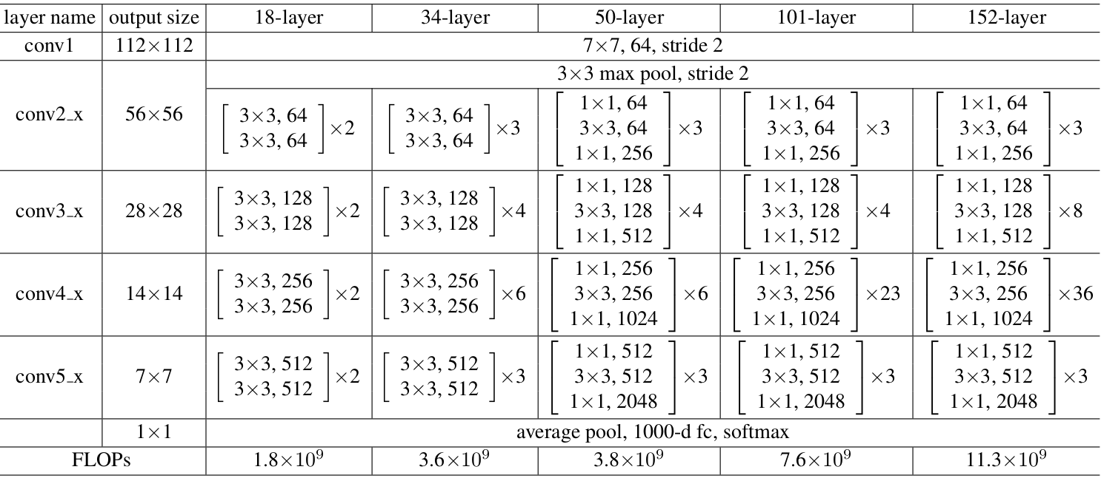
1. End-to-end Model: MobileNetV3
Model Selection
As in the previous task, I first trained with ResNet-50.

Slide 4
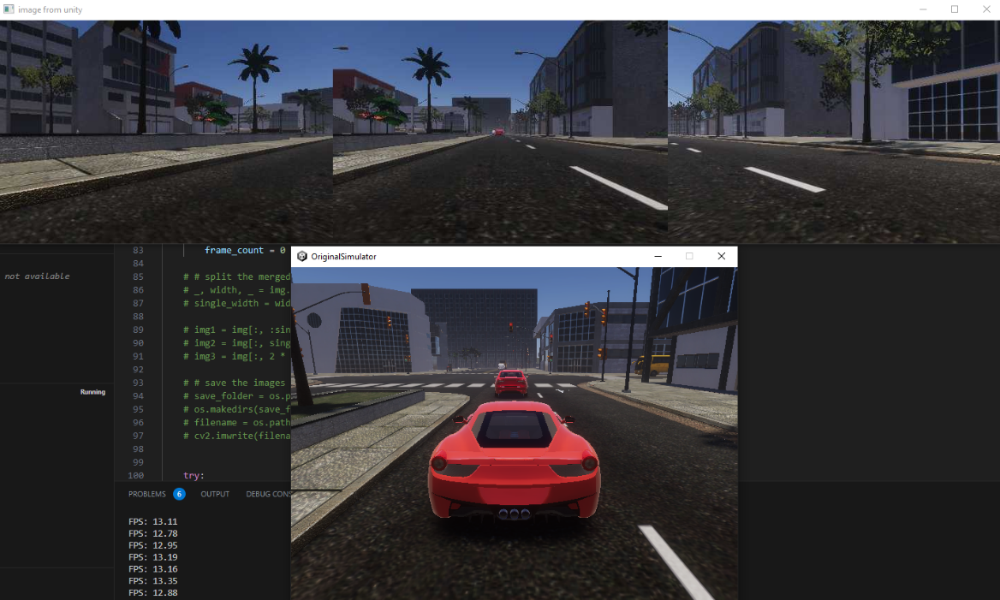
1. End-to-end Model: MobileNetV3
Problems of using ResNet-50
Too much parameters: 25.56M
Easy to overfit on our simulator-based dataset
Long training and inference time(inherent latency of simulator, latency amplified)
GitHub issue, @tarikisildar

Slide 5
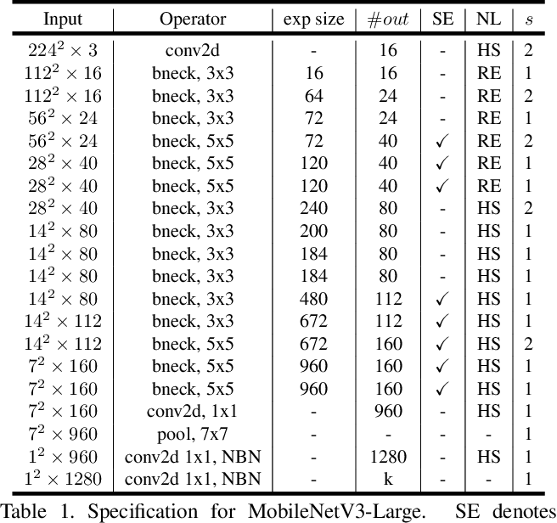
1. End-to-end Model: MobileNetV3
MobileNetV3(Large)
Introduced by Goole in 2019.

Slide 6
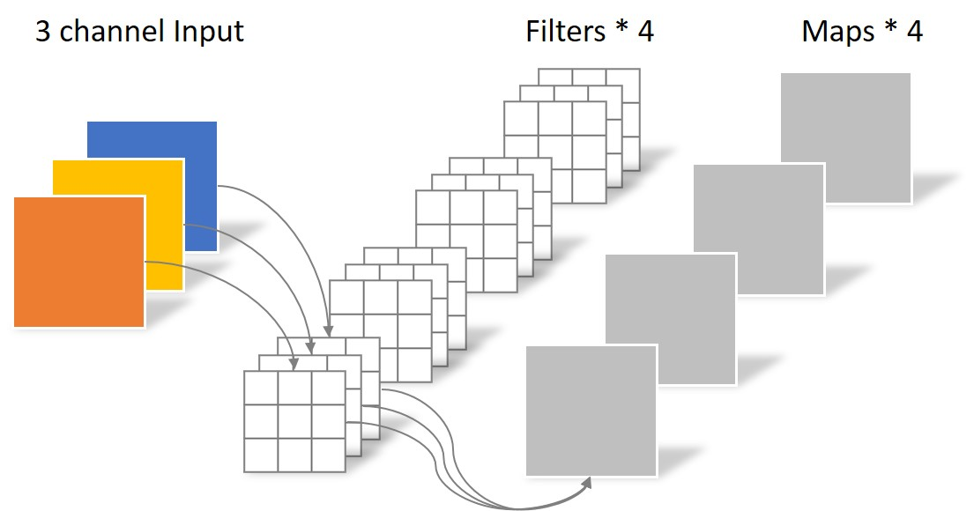
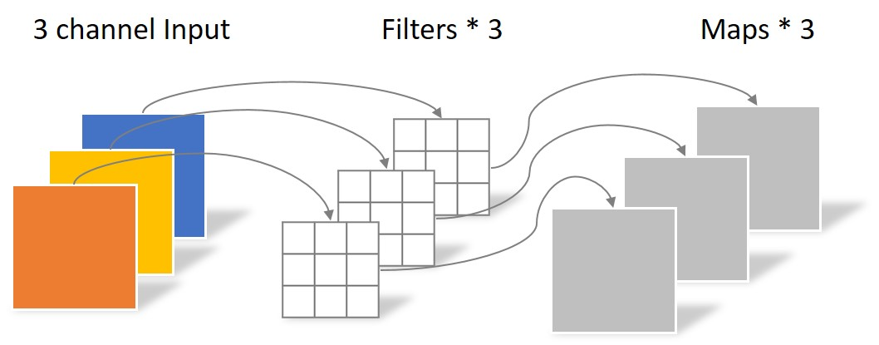
1. End-to-end Model: MobileNetV3
MobileNetV1: Introduction of depthwise convolution

Slide 7
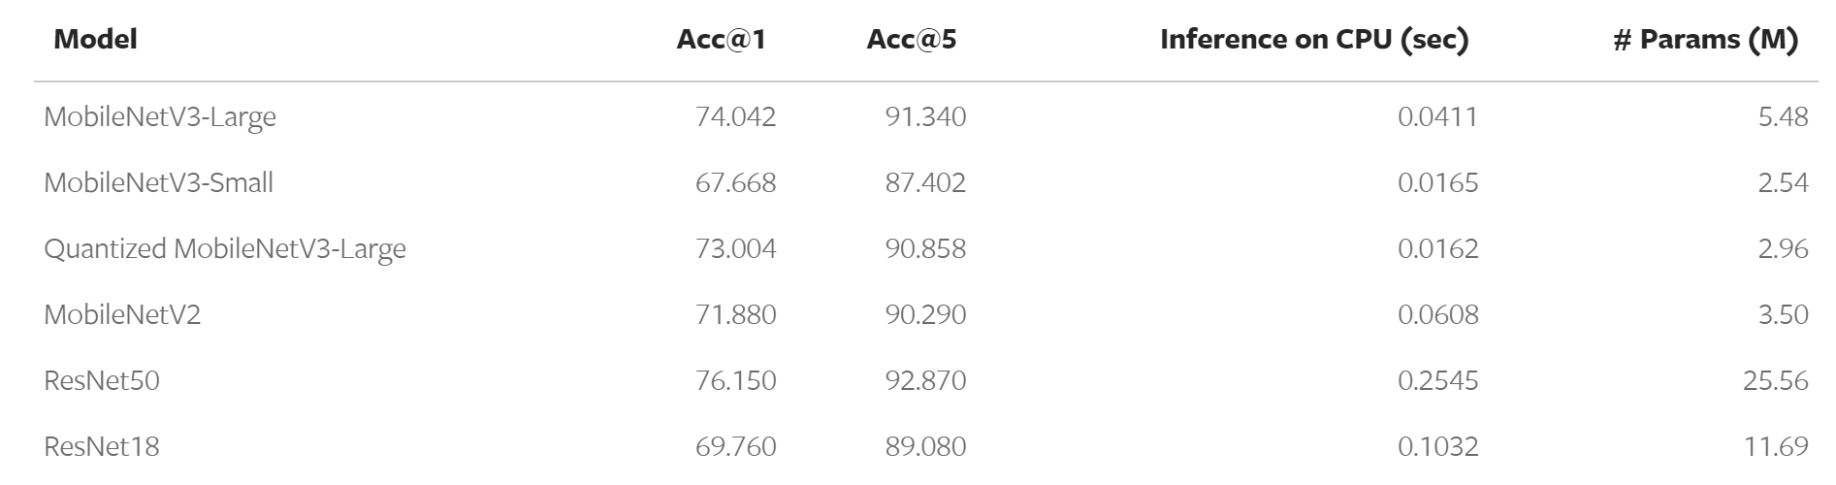
1. End-to-end Model: MobileNetV3
MobileNetV1: Introduction of depthwise convolution(30~40 layers)

Slide 8
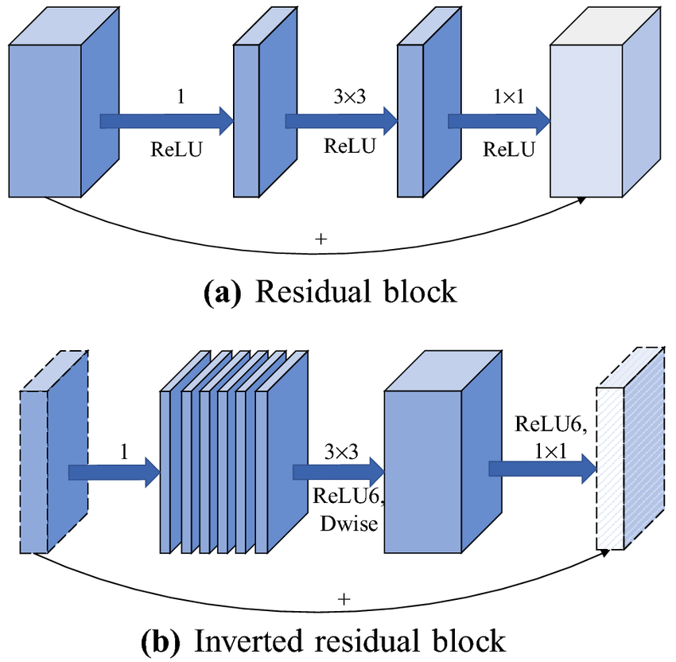
1. End-to-end Model: MobileNetV3
MobileNetV2: Inverted Residual (less info loss)

Slide 9
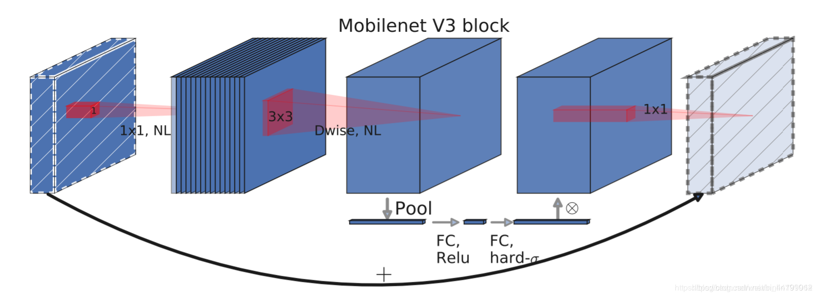
1. End-to-end Model: MobileNetV3
Back to MobileNetV3
Combine advantages of V1 and V2
Light weight attention

Slide 10
2. Detection and Segmentation: YOLOP
Dataset Preparation
BDD100K: Object detection, drivable area detection and lane detection
GPU
RTX 4070 12GB

Slide 11
2. Detection and Segmentation: YOLOP
In plain YOLO, target detection and semantic segmentation are two different models.
YOLOP combines them together, enabling the model to perform both target detection and semantic segmentation.

Slide 12
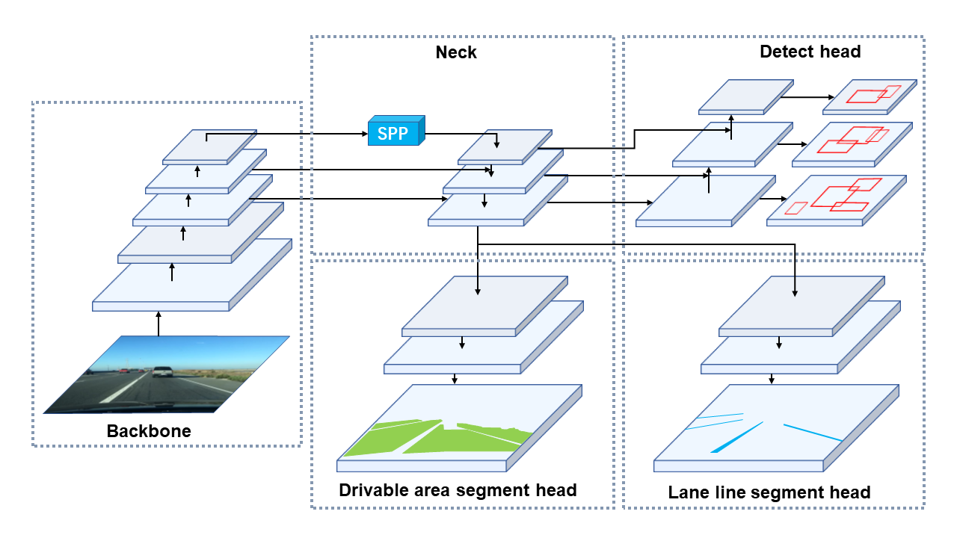
2. Detection and Segmentation: YOLOP
Structure
Backbone: CSP-Darknet, extract features
Neck: SPP and FPN, fuse features
Decoder 1: Detect Head
Decoder 2: Drivable Area Segment Head
Decoder 3: Lane Line Segment Head

Slide 13
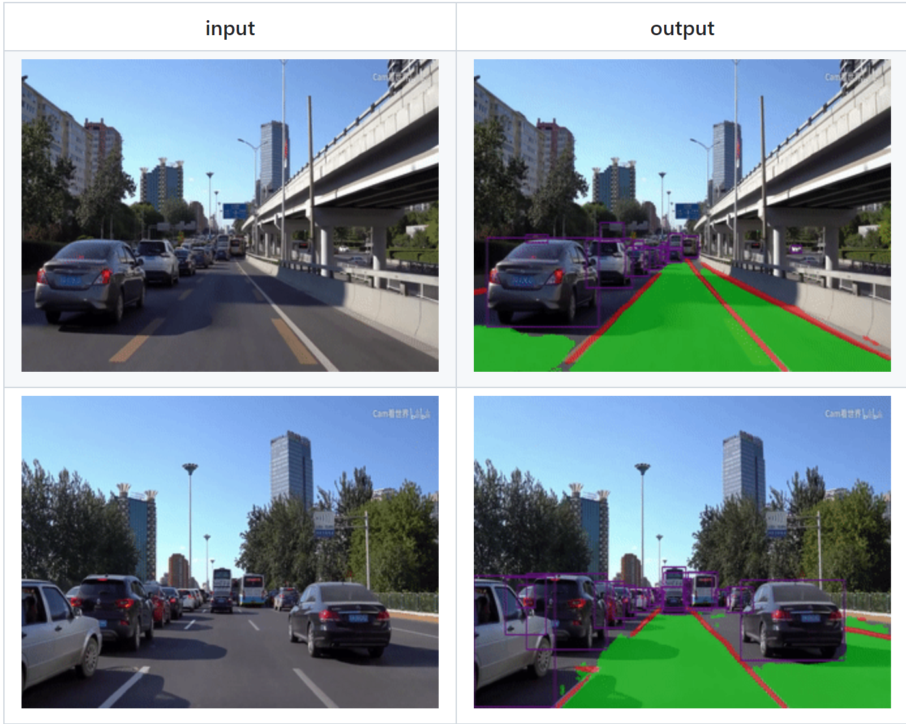
2. Detection and Segmentation: YOLOP

Slide 14
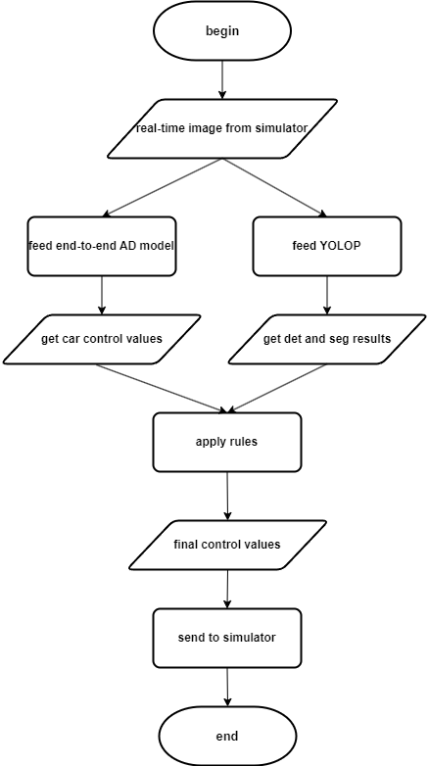
3. Combination of Two Models
drive.py Algorithm

Slide 15
3. Combination of Two Models
Rules
Is there a car in front of my car? Distance?
Is my car between lanes?
Is my car in drivable area?

Slide 16
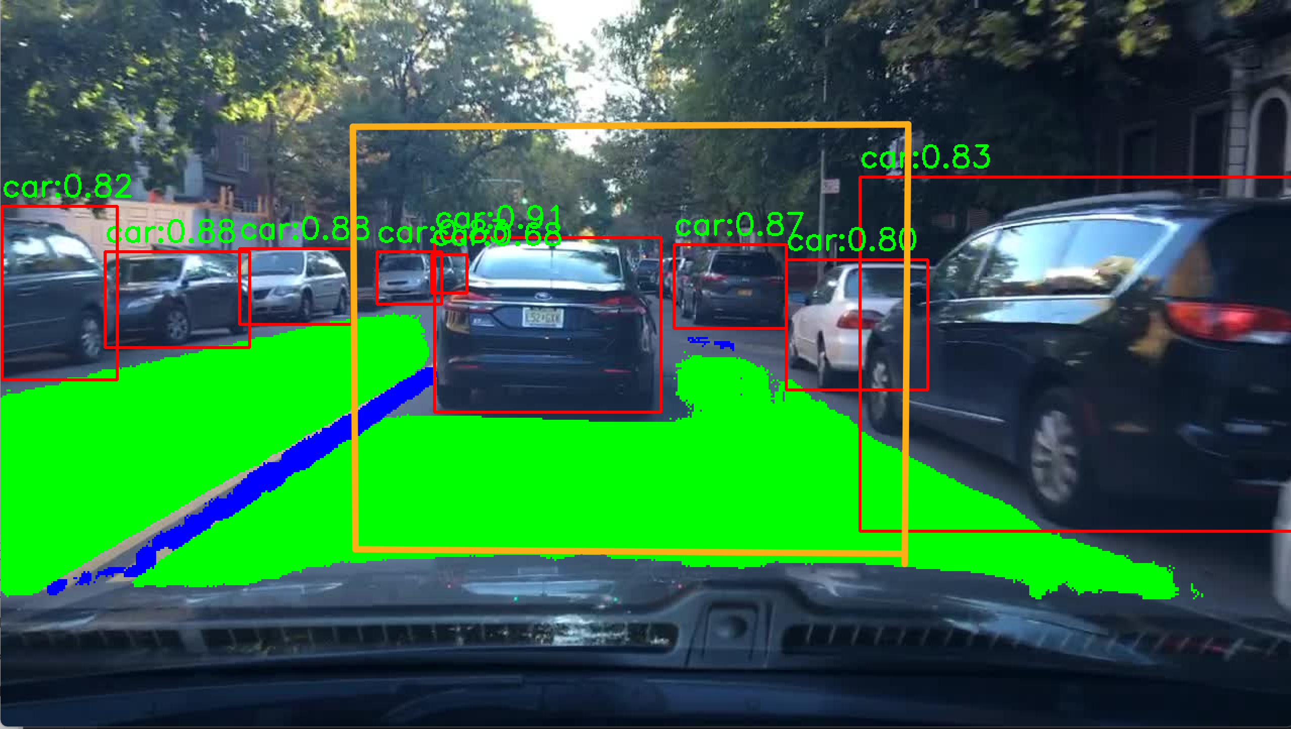
3. Combination of Two Models
Rule 1: Is there a car in front of my car? Distance?

Slide 17
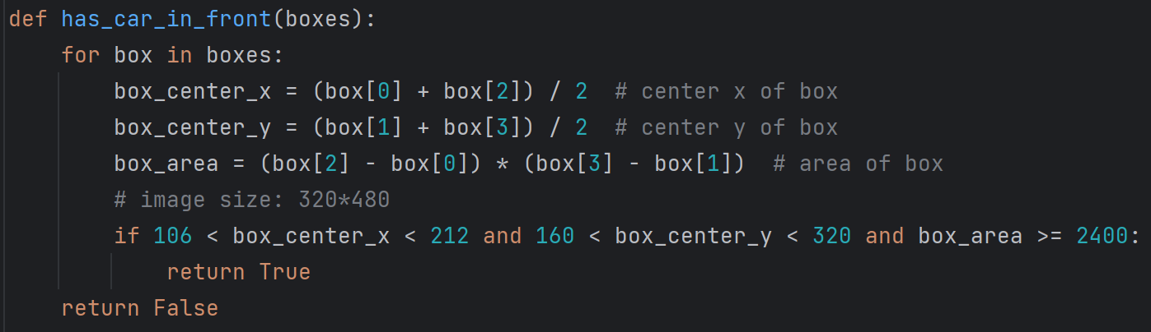
3. Combination of Two Models
Rule 1: Is there a car in front of my car? Distance?
No camera intrinsic/extrinsic matrix, calculate distance by detection box area
Only detect cars(to simplify rules, and traffic light hard to detect due to bad image quality)

Slide 18
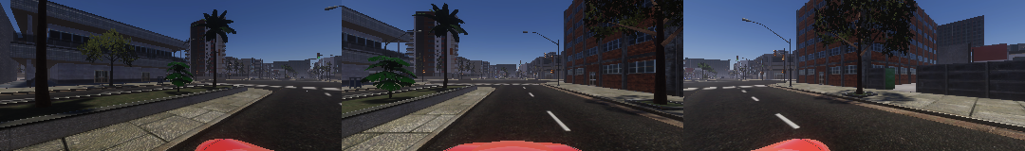
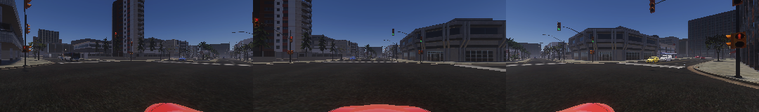
3. Combination of Two Models
Rule 2&3: Is my car between lanes? Is my car in drivable area?

Slide 19
3. Combination of Two Models
Rule 2&3: Is my car between lanes? Is my car in drivable area?
Output format of segmentation result: binary matrix of image size
Then how do we know if car in valid position?: pixel count, 15%(50% * 30%)
The lower half of the image is the roadway, as long as the number of pixels identified as lanes/driveable areas exceeds 30%, judged to be in the road
This method is very coarse and not accurate enough. But I can't think of a better method

Slide 20
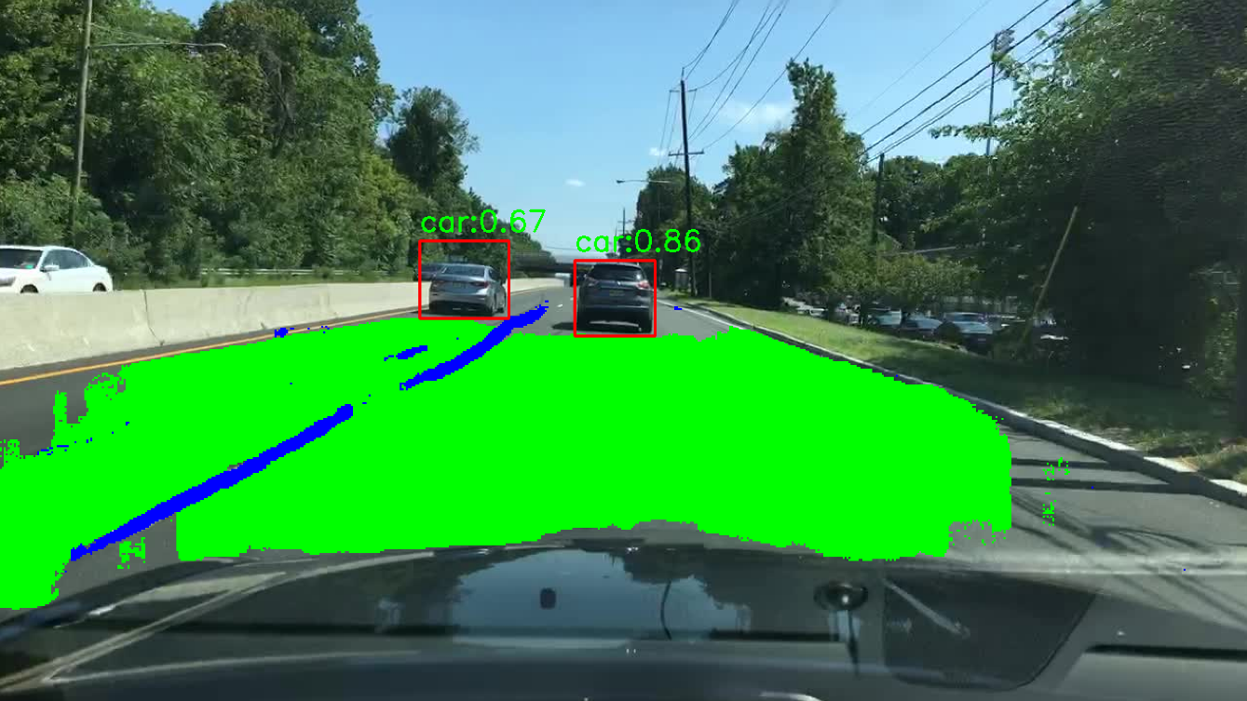
3. Combination of Two Models
Is the car to the right or to the left?
Split image in half
Left pixel counts > right ? Left : right

Slide 21
4. Demo
Simulator doesn’t work on my Mac. (Train mode doesn’t save image, test mode fps extremely low)
All the jobs are done with my PC back at home
Recorded a video this morning.

Slide 22
5. Future work
Model works not good enough.
Train YOLOP on simulator dataset(manual labeling)
Incorporate YOLOP with MobileNetV3? Real End-to-End model.

Slide 23
Thanks!

